Slide 1
People From Mars
-------------Xiaodong Liu

Slide 2
Outline
Part 1: paragraph 1 tourists is the same as extraterrestrials
Part 2: paragraph 2-4
Part 3: paragraph 5-9
Part 4: paragraph 10

Slide 3
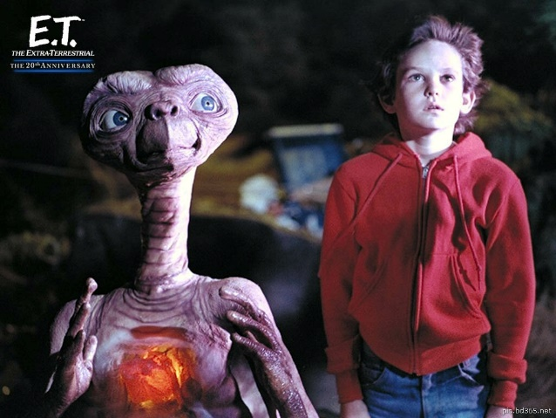
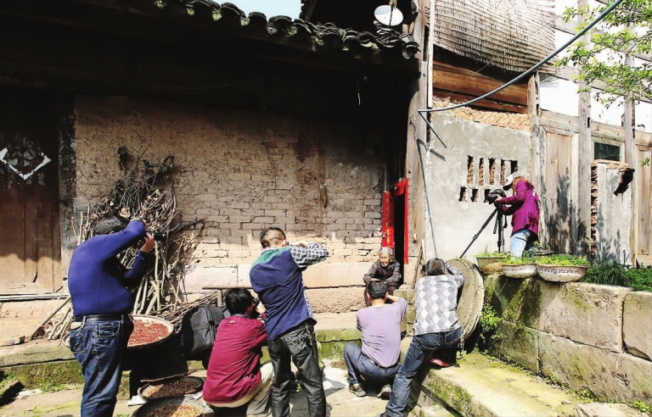
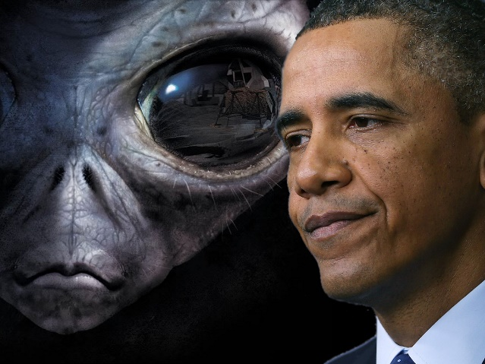
Part 1 People From Mars
Paragraph 1
tourists appeared to the traditional villagers of Ladakh
----like people from Mars

Slide 4
Part 2 The Influence of Tourism
Paragraph 2
The author gained an insight into the strong psychological pressures that modernization brings.
Our culture looks much more successful from the outside than we experience it on the inside.

Slide 5

Part 2 The Influence of Tourism
Paragraph 3 ---- The role of money changed
$100 one day for the tourists
= a Ladakhi family spend in a year
= someone spend $55000 a day in America
Past
Tourism
Modern society
A minor role
Primarily for luxuries
Basic needs were free
The labor was free
The food, clothing, and shelter
all cost a lot of money

Slide 6

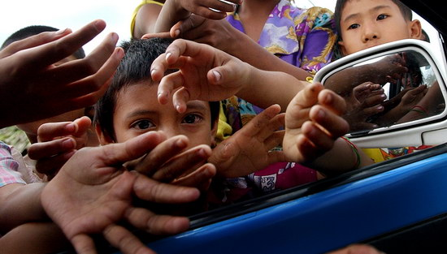
Part 2 The Influence of Tourism
Paragraph 4 ---- The Ladakhis suddenly felt poor
once
now
A strange young children run up to me
And press apricots into my hands
hold out an empty hand and
demand “One pen, one pen”

Slide 7
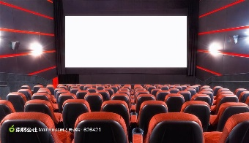






Part 3 The influence of Western films
Paragraph 5 ---- The films and television of western and Indian brought development
There are countless magical machines and they can do everything for you.
In films, the rich and the beautiful have lives filled with excitement and glamor. For the young Ladakhis, the picture is irresistible.

Slide 8
Part 3 The influence of Western films
Paragraph 6 ---- Ladakhis begin to think their lives seem primitive
Their own culture seems absurd compared with the world of the tourists and film heroes.

Slide 9
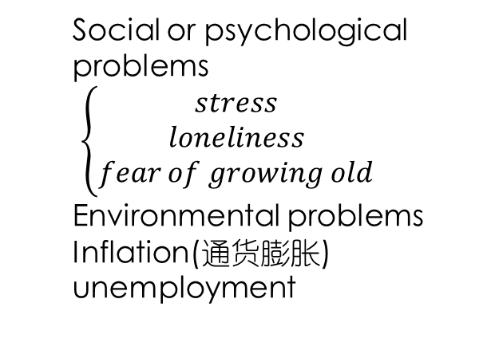
Part 3 The influence of Western films
Paragraph 7 ---- modern Western culture
can
Cannot see
The obvious wealth of Western culture
All the limitations and imperfections of their own culture
Social or psychological problems
$\left\{\begin{matrix}stress \\ loneliness \\ fear of growing old\end{matrix}\right.$
Environmental problems
Inflation(通货膨胀)
unemployment
Take for granted
Peace of mind
Warm family
Community relations of their village

Slide 10
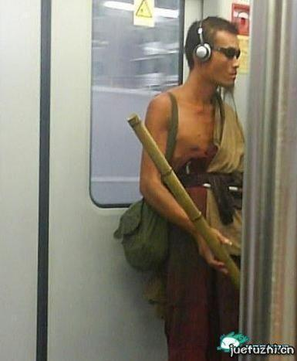
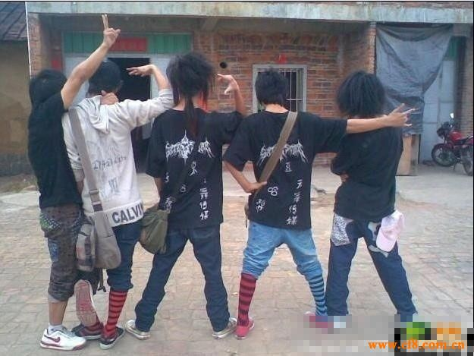
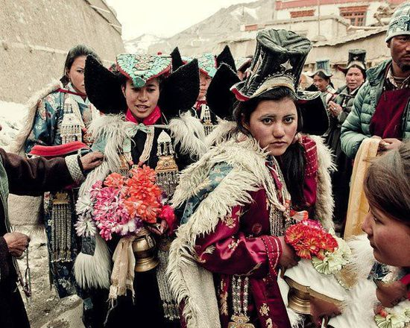
Part 3 The influence of Western films
Paragraph 8 ---- influence
Some Ladakhis develop feelings of inferiority（自卑） and reject their own culture, take on the new one
Sunglasses, Walkmans, blue jeans several sizes too small
----they are symbols of modern life.

Slide 11
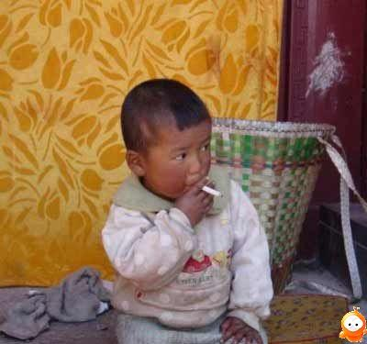
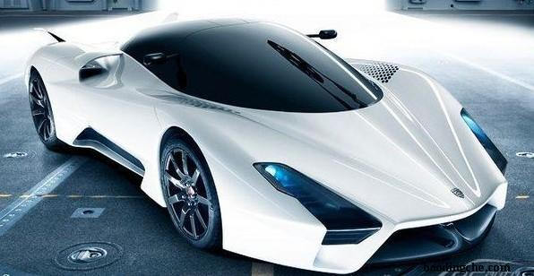
Part 3 The influence of Western films
Paragraph 9 ---- increase aggression in Ladakh with the modern symbols
According to the violence glamorized in the Western films
Smoke one cigarette, get a fast car, and race through the countryside shooting people left and right.

Slide 12
Part 4 Summary
Paragraph 10 ---- summary
In the original culture, young men used to be happy to cuddle a baby or to be loving and soft with their grandmothers. But now many young Ladakhi has changed

